Slide 1
GITOPS WITH ARGOCD

Slide 2
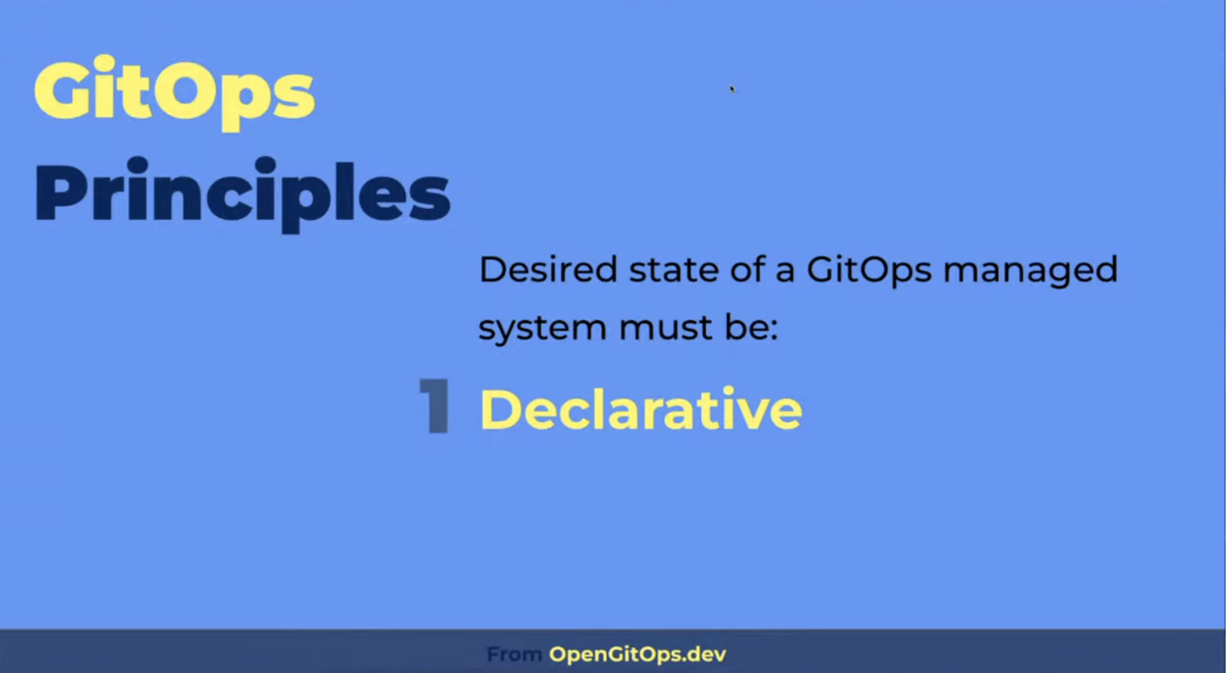
Notes:
A configuration that describes the desired operating state of a system without specifying procedures for how that state will be achieved. This separates configuration (the desired state) from the implementation (commands, API calls, scripts etc.) used to achieve that state.

Slide 3
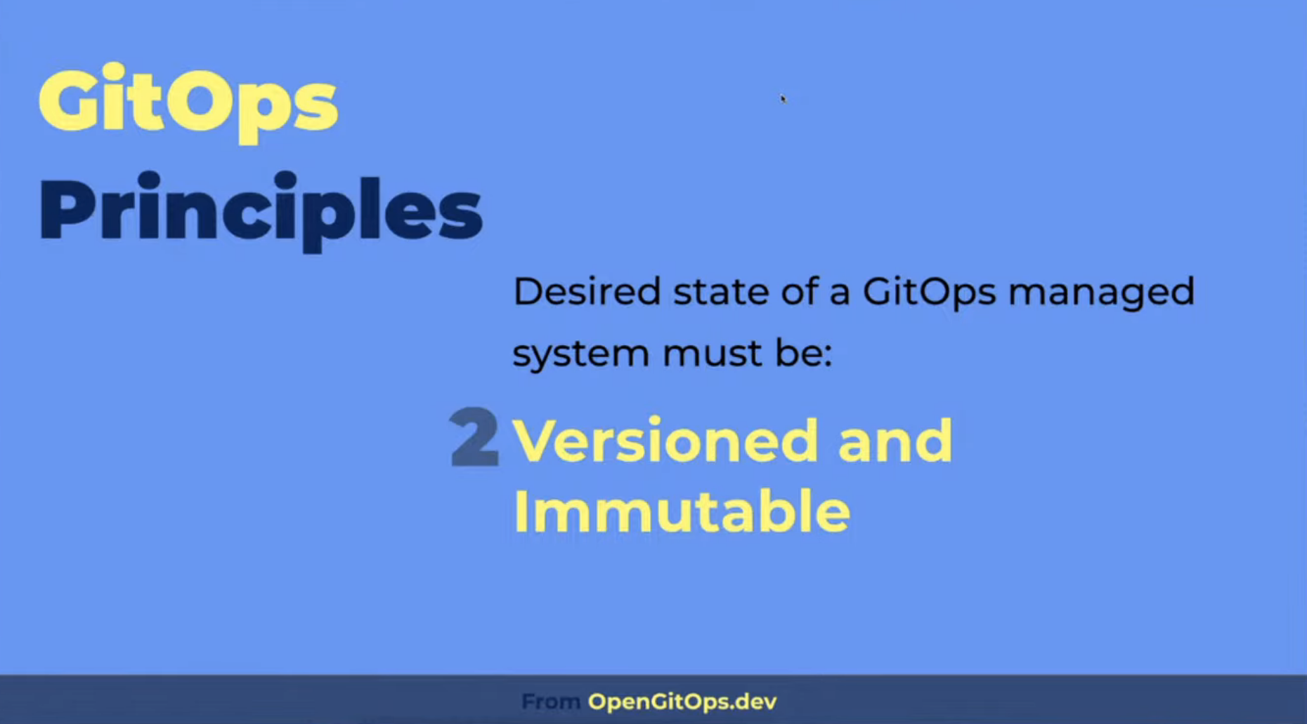
Notes:
The process of ensuring the actual state of a system matches its desired state. Contrary to traditional CI/CD where automation is generally driven by pre-set triggers, in GitOps reconciliation is triggered whenever there is a divergence. Divergence could be due to the actual state unintentionally drifting from the desired state declarations, or a new desired state declaration version having been changed intentionally. Actions are taken based on policies around feedback from the system and previous reconciliation attempts, in order to reduce deviation over time.

Slide 4
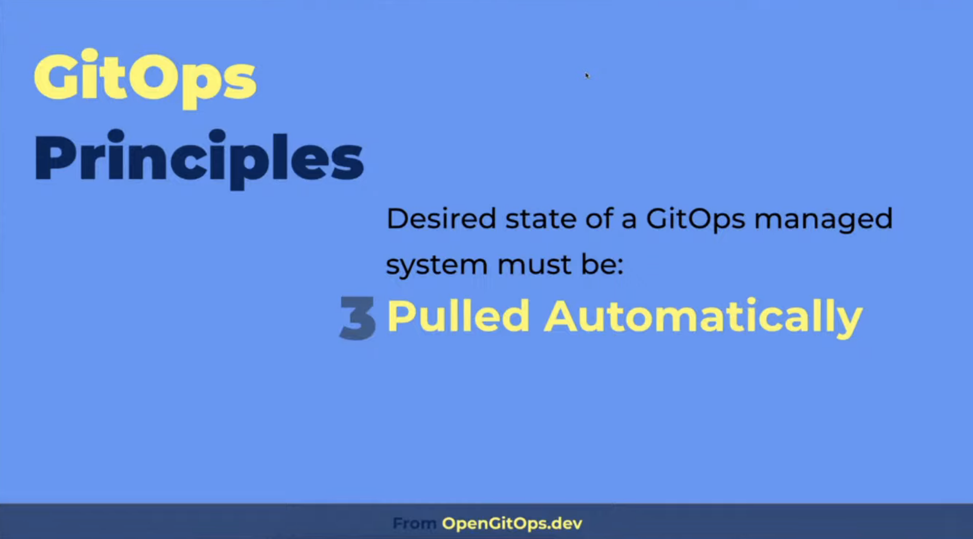

Slide 5
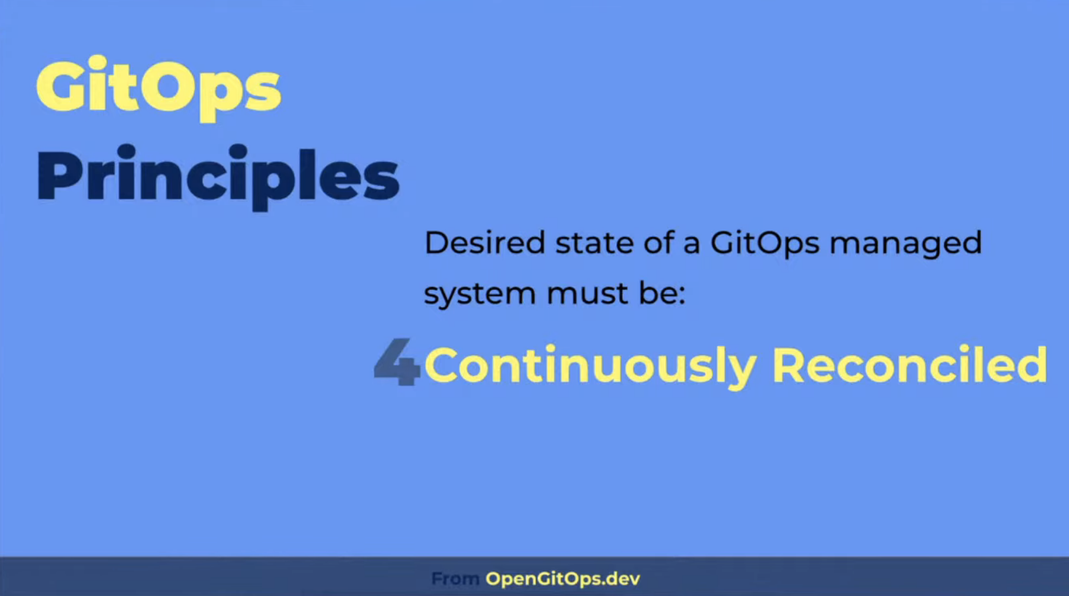

Slide 6
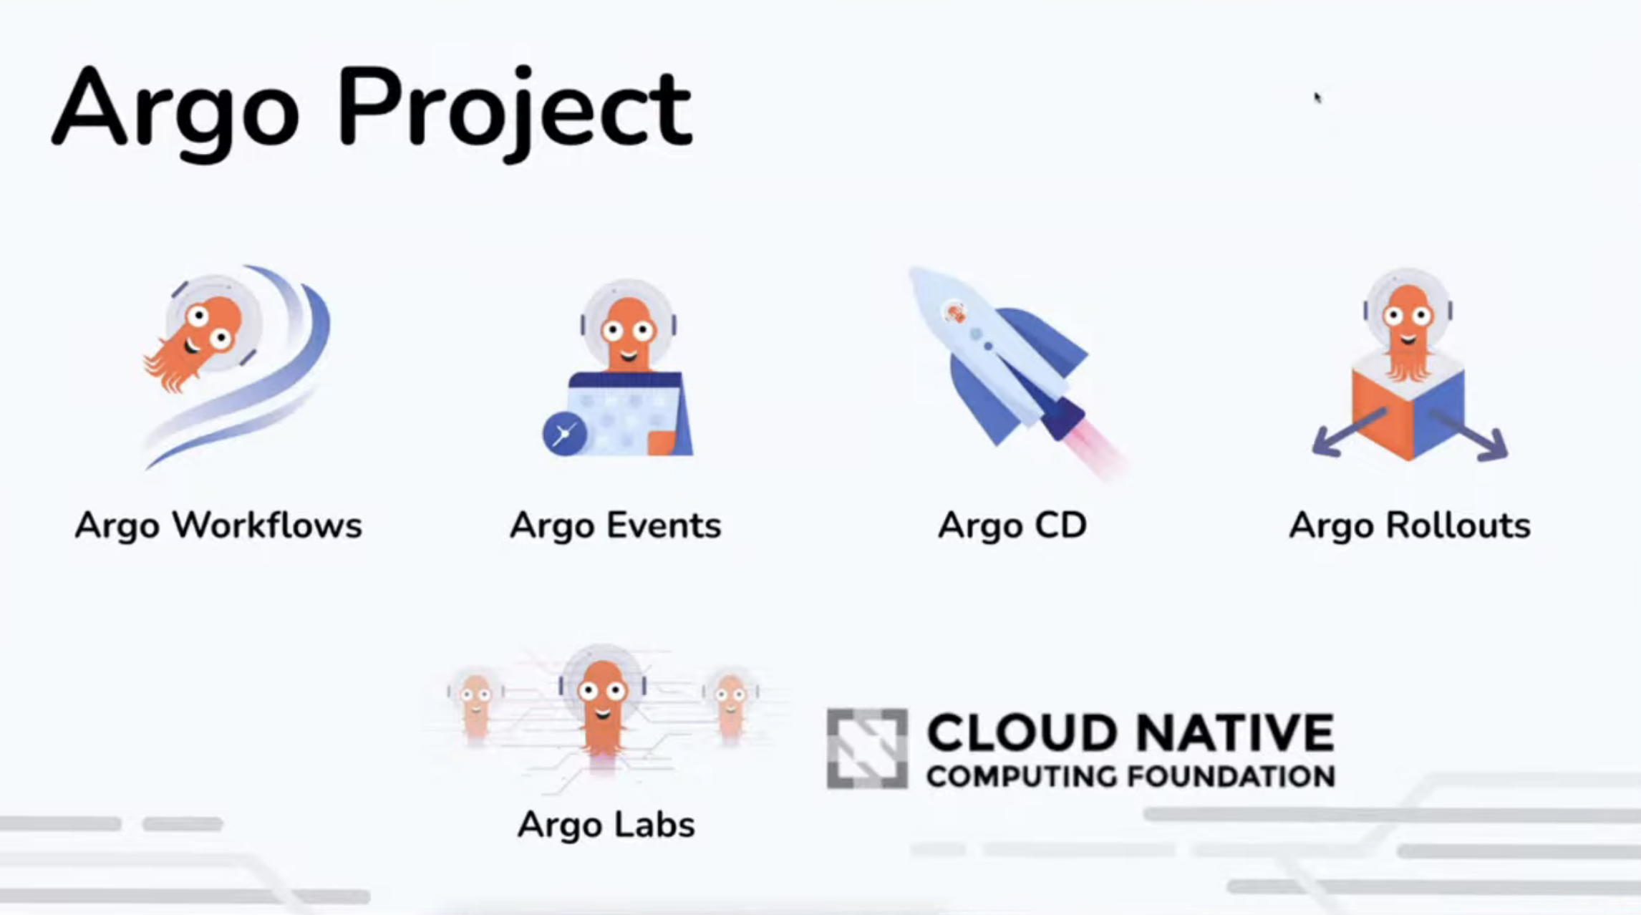
https://argoproj.github.io/

Slide 7
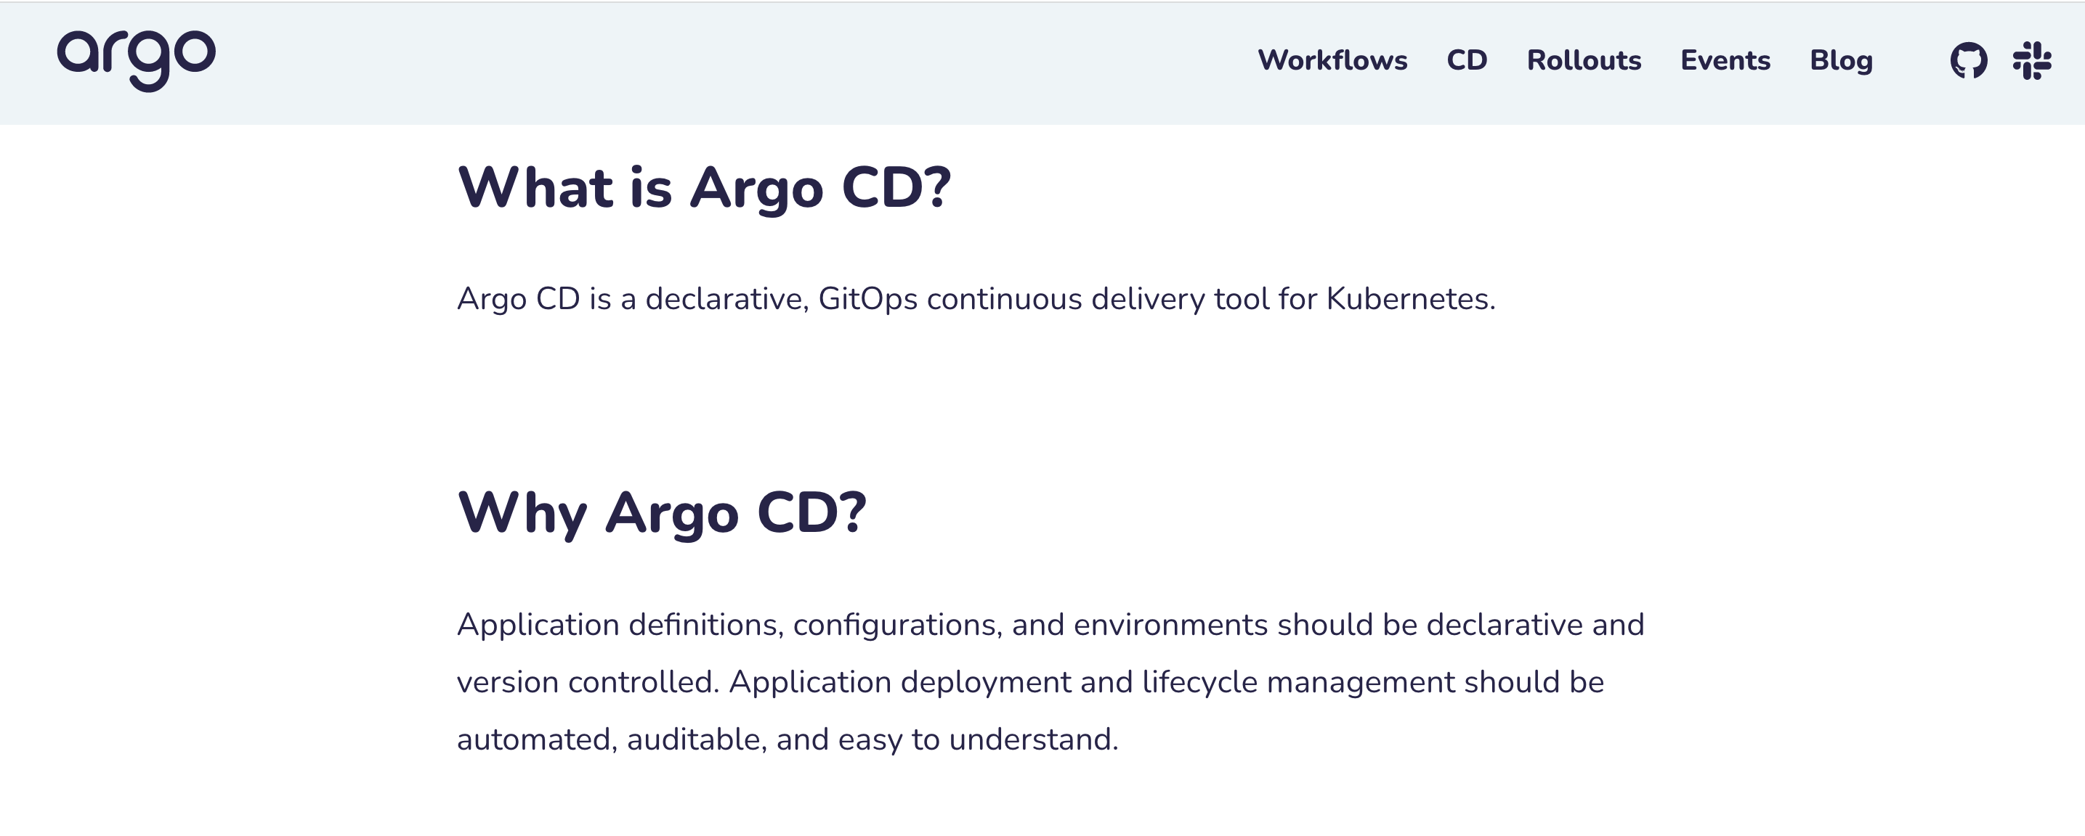

Slide 8
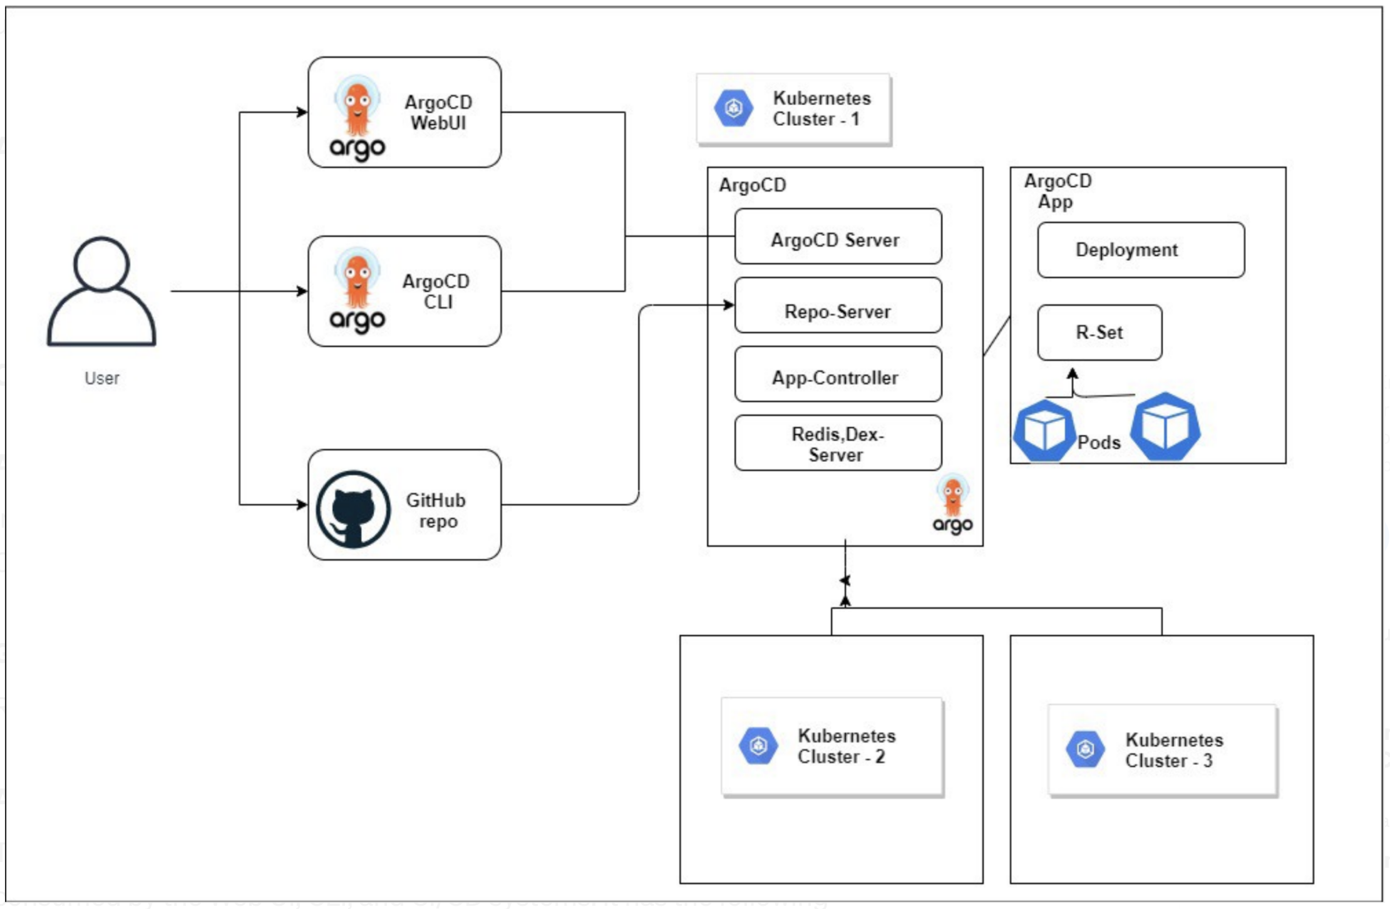
Architecture Overview
Notes:
ArgoCD/API Server
The ArgoCD/API server is a gRPC/REST server which exposes the API consumed by the Web UI, CLI, and CI/CD systems. It has the following responsibilities:
Manage the application and to report its status, Invoking of application operations (sync, rollback, user-defined actions)
Repository and cluster credential management (stored as K8s secrets), Authentication and auth delegation to external identity providers, Role-based access control (RBAC) enforcement
listener/forwarder for Git webhook events.
Repository Server
Internal service that maintains local caches of the Git repo with the application manifests. it is mainly responsible for generating and returning the Kubernetes manifests when provided the following inputs:
Repository URL, revision (commit, tag, branch), application path
Template-specific settings: ksonnet environments, parameters, helm values.yaml.
Application Controller
A Kubernetes controller which continuously monitors running applications and compares the current, live state against the desired target state (as specified in the repo). It detects OutofSync application states and optionally takes the corrective actions. This mainly responsible for invoking any user-defined hooks for lifecycle-events ( Sync, PostSync, PreSync)
Redis & Dex-Server
Redis is only used as a throw-away cache and can be lost and rebuilt without loss of service. The Dex-Server uses an in-memory database, and two or more instances would have inconsistent data.
ArgoCD App
Isolated environment for a particular application running via a repo.
Kubernetes Clusters
You can select where you want to run application on default cluster or any other one, Dex-Server will trigger that for you!.

Slide 9
Features
Automated deployment of applications to specified target environments
Support for multiple config management/templating tools (Kustomize, Helm, Jsonnet, plain-YAML)
Ability to manage and deploy to multiple clusters
SSO Integration (OIDC, OAuth2, LDAP, SAML 2.0, GitHub, GitLab, Microsoft, LinkedIn)
Multi-tenancy and RBAC policies for authorization
Rollback/Roll-anywhere to any application configuration committed in Git repository
Health status analysis of application resources
Automated configuration drift detection and visualization
Automated or manual syncing of applications to its desired state
Web UI which provides real-time view of application activity
CLI for automation and CI integration
Webhook integration (GitHub, BitBucket, GitLab)
Access tokens for automation
PreSync, Sync, PostSync hooks to support complex application rollouts (e.g.blue/green & canary upgrades)
Audit trails for application events and API calls
Prometheus metrics
Parameter overrides for overriding helm parameters in Git

Slide 10
Installation FAQ?
There are several questions that you need to answer before making a decision about installation: 1. Will your Argo CD installation manage only the cluster on which it is installed? Will it manage other clusters? Both?
2. Do you want a High Availability (HA) installation or not?
3. Do you want to use plain manifests or are you looking for a Helm chart?
4. How will you manage Argo CD upgrades? With an external system? Or do you wish for Argo CD to manage itself?

Slide 11
Installation types
Regular install
Standard Argo CD installation with cluster-admin access. Use this manifest set if you plan to use Argo CD to deploy applications in the same cluster that Argo CD runs in (i.e. kubernetes.svc.default). It will still be able to deploy to external clusters with inputted credentials.
HA install
High Availability installation is recommended for production use. This bundle includes the same components but tuned for high availability and resiliency.
ha/install.yaml - the same as install.yaml but with multiple replicas for supported components.
Core install
The core installation is most suitable for cluster administrators who independently use Argo CD and don't need multi-tenancy features. This installation includes fewer components and is easier to setup. The bundle does not include the API server or UI, and installs the lightweight (non-HA) version of each component.

Slide 12
Installation via:
Argo auto-pilot
https://argocd-autopilot.readthedocs.io/en/stable/
https://github.com/argoproj-labs/argocd-autopilot
Helm:
https://github.com/argoproj/argo-helm/tree/main/charts/argo-cd
Manifest:
https://github.com/argoproj/argo-cd/tree/master/manifests
Notes:
For a production setup we suggest you use Autopilot, a companion project that not only installs Argo CD, but commits all configuration to git so Argo CD can manage itself using GitOps. For more traditional installation options, the manifests directory offers different modes of installation with or without High Availability. The installs marked as “namespace” allow you to install Argo CD on a single namespace without cluster-wide privileges. This is best when you want to install Argo CD on one cluster but have it manage other external clusters.
A community helm chart is also available at https://github.com/argoproj/argo-helm/tree/master/charts/argo-cd

Slide 13
Configuration Options
Regarding configuration options, Argo CD can be customized a lot after the initial installation, but the absolute essentials are:
Decide how to expose Argo CD API/UI to your users.
Ingress (recommended for production)
Load balancer (affects cloud cost)
NodePort (simple but not very flexible)
Decide how users are going to authenticate to Argo CD:
- Internal DB
- SSO
https://argo-cd.readthedocs.io/en/stable/operator-manual/user-management/

Slide 14
ArgoCD Application
An application can be created in Argo CD from
UI
CLI
Kubernetes manifest that can then be passed to kubectl to create resources.

Slide 15
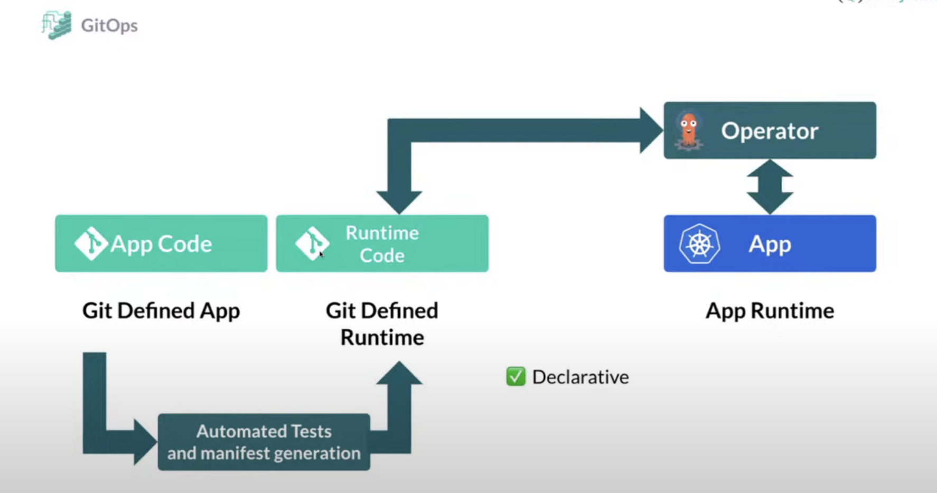

Slide 16
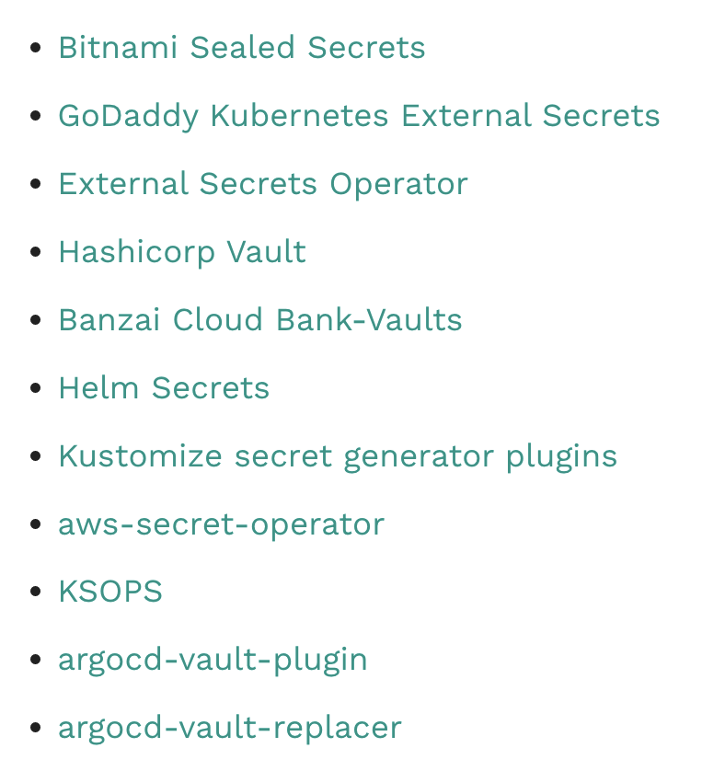
Secret Managment
https://argo-cd.readthedocs.io/en/stable/operator-manual/secret-management/

Slide 17
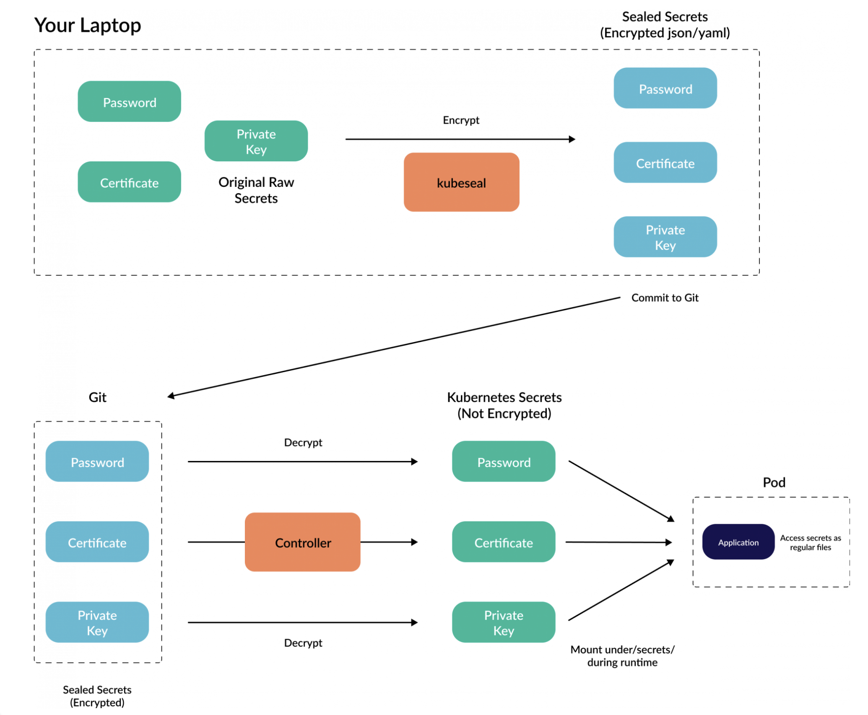
Bitnami Sealed Secrets

Slide 18
https://github.com/argoproj-labs

Slide 19
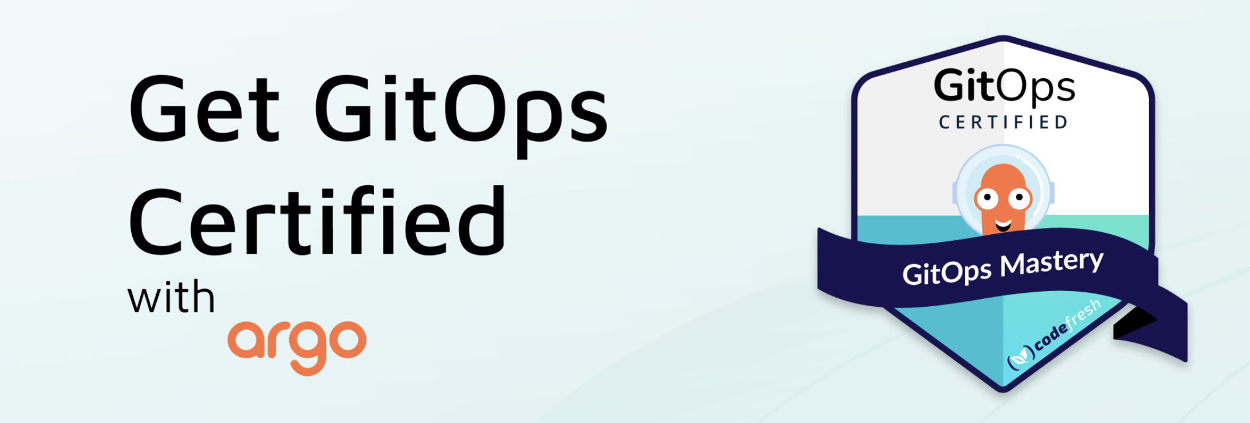
https://codefresh.io/blog/get-gitops-certified-argo/ https://github.com/codefresh-contrib/gitops-certification-examples

Slide 20

https://events.linuxfoundation.org/argocon/

